Slide 1
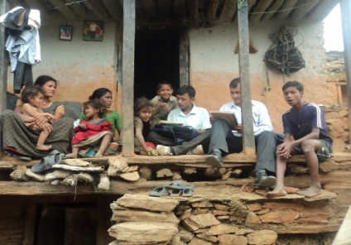
HIV Prevention Program Reaching Nepalese Migrants and Their Spouses both at Source and Destination Authors: Umesh Gahatraj¹, Prakash Pandeya¹, Upasana Shakya¹ , Nabesh Bohidar², Prakash Madai³, Bipin Thapa⁴ Affiliations: ¹CARE Nepal, ²CARE India, ³NEEDS, ⁴GaRDeF
Introduction
With the aim of reducing the vulnerability of key mobile population to HIV & AIDS and ensuring safer mobility along routes of Bangladesh and Nepal to India, CARE offices at Nepal, India and Bangladesh is jointly implementing EMPHASIS project which delivers focused intervention at source , transit and destination. The project has been practicing various models through its implementing partners in all three countries at district level to generate awareness., enhance access of service and provide support related to HIV & safe mobility. However, there is no systematic mechanism to generate the evidence to measure number of people benefited at both source and destination. Therefore, project has initiated tracking of impact population across border to ensure the continuum of care to the impact population is being made. Consequently, it has contributed to make service easily accessible and also broaden the scope of intervention.
Project or Activities
Results
Number of Impact Population Contacted at Source who were Reached at Destination
CARE EMPHASIS project urged new cross border HIV prevention program targeting Nepalese migrants not only at source in Nepal, but also in destination cities in India. The program adopted peer education, outreach education, drop in centers (DIC), mobile DIC strategies to reach Nepalese migrants at both source and destination cities. CARE India and CARE Nepal EMPHASIS project worked together to reach the Nepalese migrants in both countries to contribute to the dissemination of information concerning HIV and AIDS, STI and ART services. The project has 360 Peer educators (PEs), 10 outreach workers (ORW)from 8 DICs in source communities and 125 PEs, 29 ORW,11 DICs and mobile DICs from host communities were mobilized to reach the Nepalese migrants in India. Both teams’ joined efforts enabled the project to reach 348 people simultaneously at destination and at source, tracking their mobility patterns and access to services.
In total 3588 migrants from Achham and Kanchanpur were reached at destination by partners of CARE India since Jan, 2010 to May, 2012.Of them, 348 impact population were calculated as sample size who were contacted at source communities. Nearly 61% people of total sample size were tracked at Source who were reached at Destination. n Among total respondent tracked , nearly 24 % migrants were found to have accessed different level of service at both source and destination followed by Son/daughter (22.6%), Spouse (21.7%), Parent (17.9%) and Other (14.2%). Among them 72% were married and 28 % were single. 79% migrants were found literate. 73% have formal educational background. The project successfully reached Nepalese migrants in both source and destinations and proved that a cross-country project can be implemented to reduce the HIV vulnerability among migrants. Countries’ programs worked closely to reach the Nepalese migrants and established the partner-to-partner organization communication through regular cross border meetings.
Materials and Methods
CARE India
EMPHASIS, Regional Secretariat
CARE Nepal
Partners at destination Maintained Database
Partners at Source Sharing of Information
Orientation to ORWs and PEs on Tool
Reaching Migrants and their Spouses at Source and Destination
Mobilized ORW-29, PEs-125 & operating DICs-11 at destination sites to collect data
Conclusion/ Learning
Mobilization of ORW-10 and PEs - 360
Both sending and receiving countries’ programs' coordination is an important strategy to make the project successful. For close and continuous cooperation between the two teams, it is vitally important to conduct regular sharing meetings, communicate through different channels, and ensure constant exchange of ideas.
People Reached at destination (N=3588)
Tracking of Impact Population at source Communities (n= 348)

